Slide 1
Data Structures Chapter 5 Tree
introduction
Definition and Terminology
Binary tree
Definition and Properties
Traversal - Quizzes
Coding
Binary search tree
Tree balancing

Slide 2
Binary tree traversals
Exercise 1:
preorder Traversal(VLR ):
inorder traversal(LVR ) :
postorder traversal(LRV):
Level Order traversal :
+
*
5
2
4

Slide 3
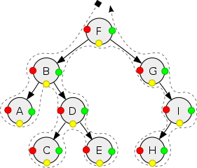
Binary tree traversals
Exercise 2:
preorder Traversal(VLR )
inorder traversal(LVR )
postorder traversal(LRV)
7
25
1
9
10
29
8
7
15
25
35
0
3
10
10
17
30
2
5
4
6

